Slide 1
LIBRARIES
&
PIXEL MANIPULATION

Slide 2
AGENDA
Understand the basics of libraries and start experimenting
Use image processing to do some fun stuff with pictures

Slide 3
IMAGE PROCESSING
PImage review
Image display
Changing colors
Static and dynamic image processing

Slide 4
How can we define a digital image?
Notes:
nothing more than data - numbers indicating variations of red, green, and blue at a particular location on a grid of pixels (2 dimensional array)

Slide 5
Review: PImage is a handy Processing-defined class for storing and using images.

Slide 6
PImage review
// Declaring a variable of type PImage PImage img;
void setup() { size(320,240); // Make a new instance of a PImage by loading an image file img = loadImage("myPhoto.jpg");
}
void draw() { background(0); image(img,0,0);
}

Slide 7
Tint (one argument) - black to “white” blending
tint(100); - makes an image darker
tint(255); - default state
Tint (two arguments) - + alpha blending
tint(255,137); - 50% opacity (alpha)
Tint (three arguments) - RGB
tint(255,0,0); - red blending
what about four arguments?

Slide 8
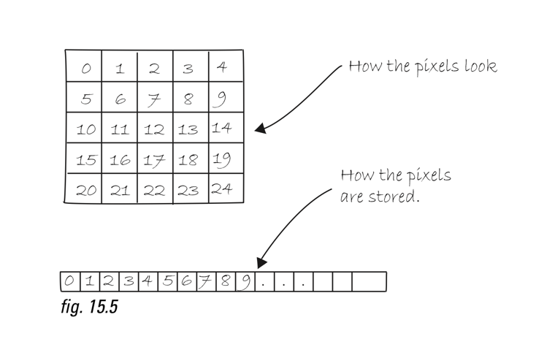
Basic Pixel manipulation

Slide 9
loadPixels( )—This function is called before you access the pixel array, saying “load the pixels, I would like to speak with them!”
updatePixels( )—This function is called after you finish with the pixel array, saying “Go ahead and update the pixels, I’m all done!”
Notes:
do set-pixel sketch

Slide 10
We can use for loops to get data from every pixel on the screen.
for (int i = 0; i < pixels.length; i++) {
// Pick a random number, 0 to 255
float rand = random(255);
// Create a grayscale color based on random number
color c = color(rand);
// Set pixel at that location to random color
pixels[i] = c;
}
Notes:
uses the pixels[] array that loadPixels() generates

Slide 11
We can also do a two-dimensional loop to get x and y values of a location with a simple formula
for (int x = 0; x < width; x++) {
// Loop through every pixel row
for (int y = 0; y < height; y++){
// Use the formula to find the 1D location
int loc = x + y * width;
float distance = dist(x,y,width/2,height/2);
pixels[loc] = color(distance);
}
}
Notes:
loops through width and height, using the formula to find the position in the pixels[] array as generated by loadPixels()

Slide 12
We can do the same with images
for (int y = 0; y < img.height; y++) {
for (int x = 0; x < img.width; x++) {
int loc = x + y * width;

Slide 13
This lets us do all sorts of things with this data
Photoshop style filters
Histograms
Image visualizations
or just arbitrary changes?

Slide 14
examples...

Slide 16
HW
Hack a contributed library example. Add sliders to a previous sketch for realtime control. Try using a second window. Do something with sounds. Give a previous sketch box2d physics. etc.
Real time procedural portrait.
Do something cool with an image, capture an picture of it.
For more… try realtime video capture to use instead of a static image.

